Slide 1
PROJECT PRESENTATION Topic: SKIP LIST
Group Members:
MUHAMMAD HARRIS HASSAN (19B-090-CS)
SAMEER ULLAH KHAN (19B-068-CS)

Slide 2
TABLE OF CONTENTS:
SKIP LIST (DEFINITION)
USE OF SKIP LIST
SKIP LIST SIMPLE STRUCTURE
COMPLEXITY TABLE OF SKIP LIST
SKIP LIST ALGORITHMS

Slide 3
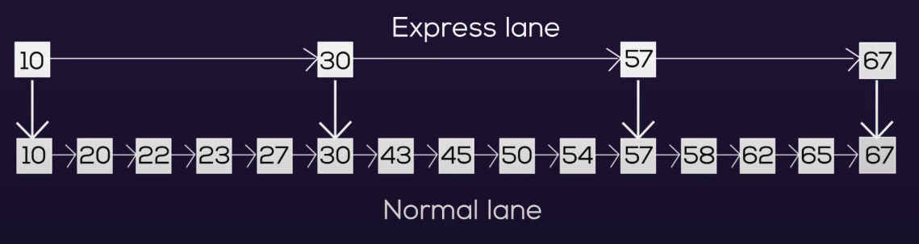
DEFINITION
Skip list is a probabilistic data structure where elements are kept sorted by the keys.
The idea is simple, we create multiple layers in a sorted list so that we can skip some nodes.
It is basically a linked list with additional pointers such that intermediate nodes can be skipped.

Slide 4
Why we use Skip List?
It is one of the fastest searching technique
It allows quick search, insertion and deletion of element with simple algorithm.
A skip list allows the process of item look up in efficient manner.
Skip lists are very useful when you need to be able to concurrently access your data structure.

Slide 5
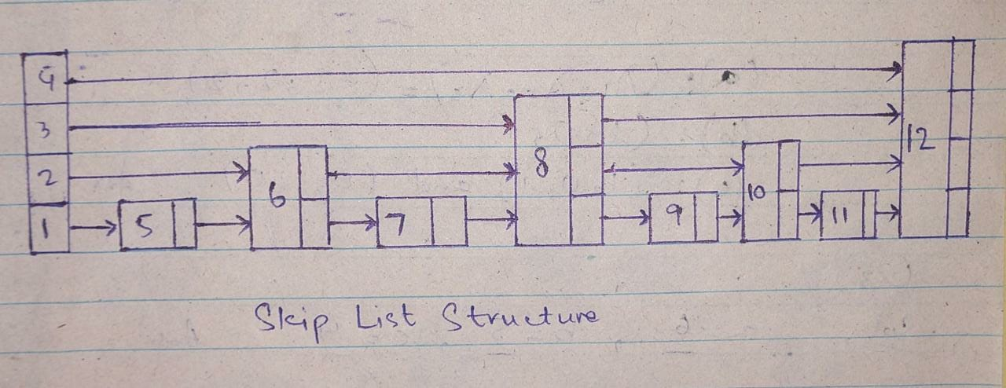
SKIP LIST STRUCTURE
Skip list with “n” nodes:
Every second node point to the second position a head.
Every fourth node point to the second position a head.

Slide 6
COMPLEXITY TABLE OF SKIP LIST
S. No. | Complexity | Average Case | Worst Case
1. | Access Complexity | O(logn) | O(n)
2. | Search Complexity | O(logn) | O(n)
3. | Insert Complexity | O(logn) | O(n)
4. | Delete Complexity | O(logn) | O(n)

Slide 7

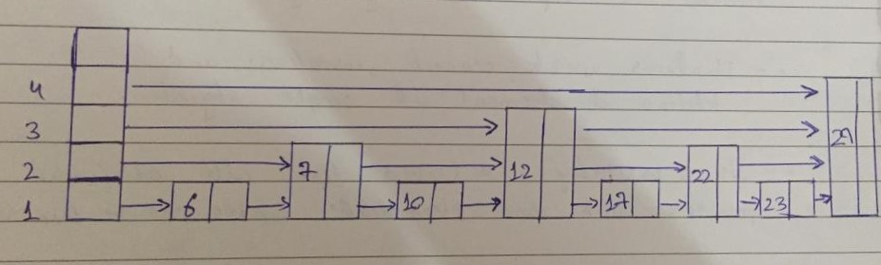
SEARCH ALGORITHM
find_pred_node(x)
u←sentinel
r ← h
while r ≥ 0 do
while u.next[r] ≠ nil and u.next[r].x < x do
u ← u.next[r] # go right in list r
r ← r − 1 # go down into list r-1
return u
find(x)
u ← find_pred_node(x)
if u.next[0] =nil then return nil
return u.next[0].x

Slide 8
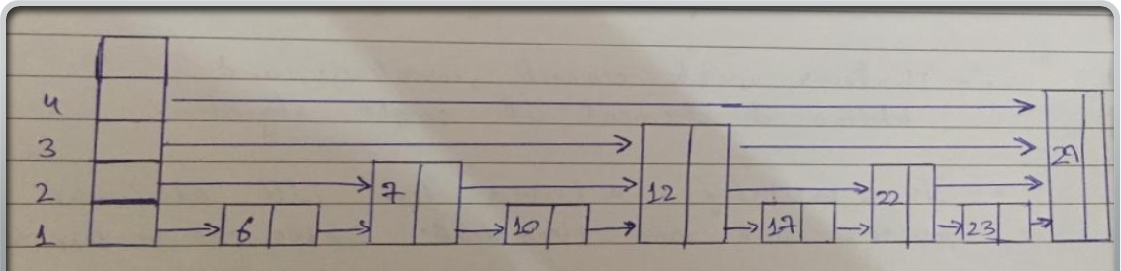
INSERT ALGORITHM
add(x)
u ← sentinel
r←h
while r ≥ 0 do
while u.next[r] ≠ nil and u.next[r].x < x do
u←u.next[r]
if u.next[r] ≠ nil and u.next[r].x = x then return false stack[r] ← u
r ← r − 1
w←newnode(x,pickheight())
while h < w.height() do
h ← h + 1
stack[h] ← sentinel # height increased
for i in 0,1,2,...,len(w.next) −1 do
w.next[i]←stack[i].next[i]
stack[i].next[i]←w
n ← n + 1
return true

Slide 9
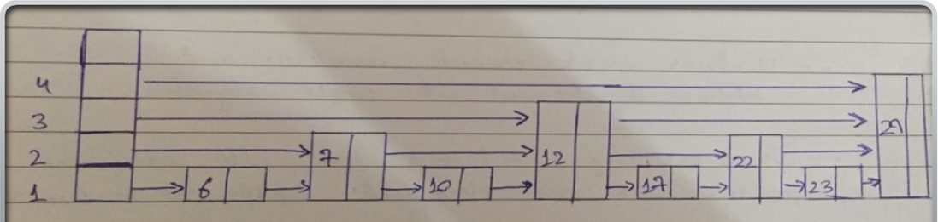
DELETE ALGORITHM
remove(x)
removed ← false
u←sentinel
r←h
while r ≥ 0 do
while u.next[r] ≠ nil and u.next[r].x < x do
u←u.next[r]
if u.next[r] ≠ nil and u.next[r].x = x then
removed ← true
u.next[r] ← u.next[r].next[r]
if u = sentinel and u.next[r] = nil then
h ← h − 1 # height has decreased
r←r−1
if removed then n ← n − 1
return removed

Slide 10


